Slide 1


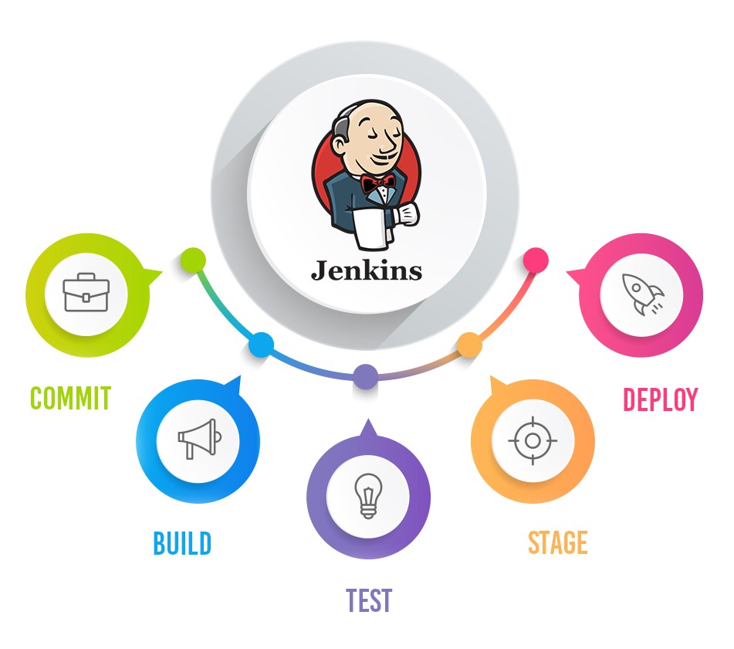
Jenkins Mastery for Software Tester
Pramod Dutta
Multi Branch Pipeline Job using Jenkins

Slide 2

What we need Multi Branch Pipeline Job using Jenkins
Run your Job every time there is new branch
Check Previous Video on Pipeline
Simple Jenkins Files as of now
You can same Selenium Maven Run Jenkins File.
Helpful in running build for every branch

Slide 3
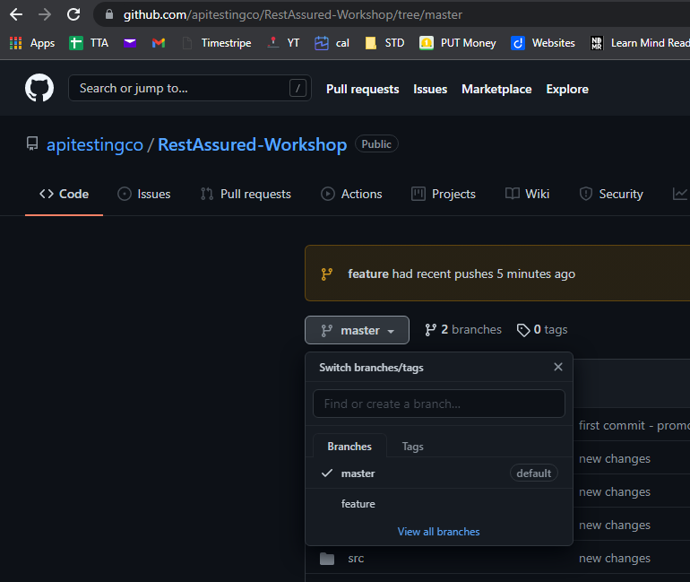
What we need Multi Branch Pipeline Job using Jenkins
https://github.com/apitestingco/RestAssured-Workshop/tree/master

Slide 4
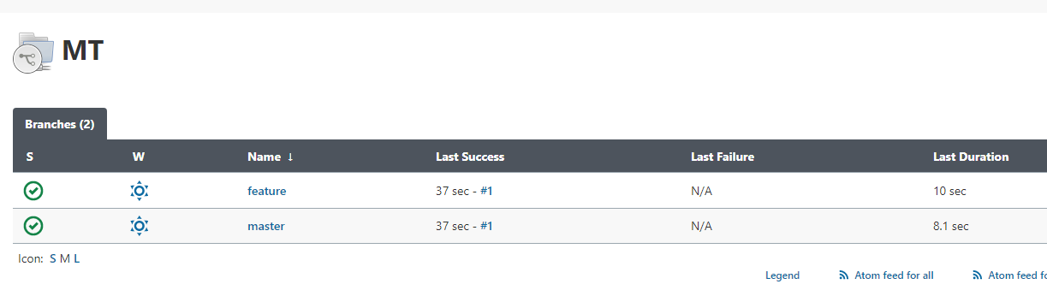
What we need Multi Branch Pipeline Job using Jenkins
https://github.com/apitestingco/RestAssured-Workshop/tree/master

Slide 5
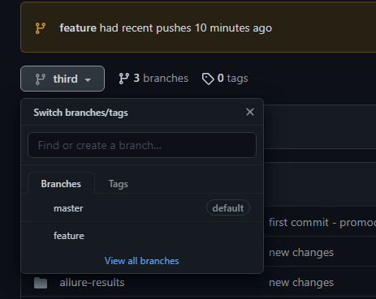
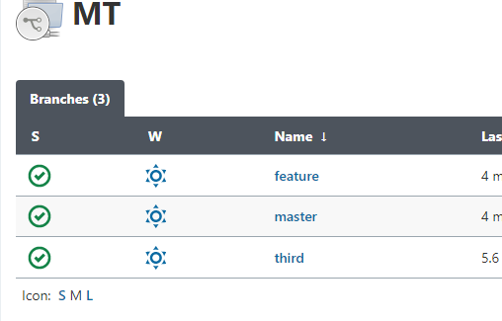
Lets Create new Branch and Check

